Slide 1
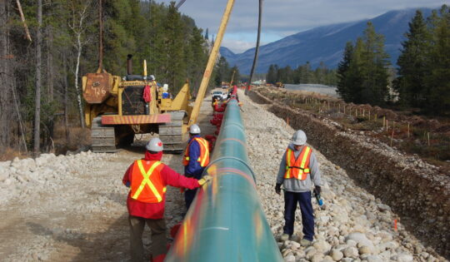
Data-410 – Final Presentation Alberta to British Columbia Trans Mountain Expansion Project

Slide 2

1 – Business Understanding –High Level
Notes:
For the High Level Business Understanding focus on the Case Study supplied.

Slide 3
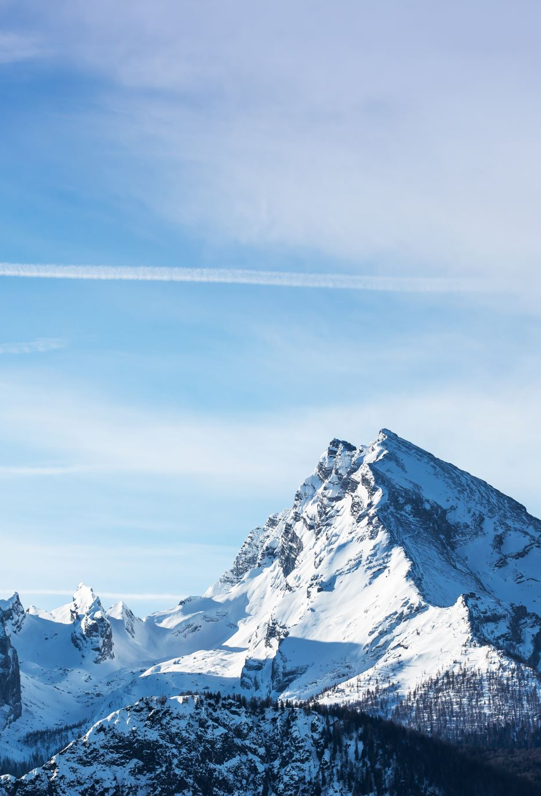
Case Study
Case Study – The Alberta To British Columbia Trans Mountain Expansion Project
Reference Link -
https://cases.open.ubc.ca/the-alberta-to-british-columbia-trans-mountain-expansion-project/

Slide 4
Introduction
Perspective – The scope of Trans Mountain Pipeline Expansion project is engulfed by Legal, Political, Social and Environmental complications including variety of stakeholders. Our data analysis company, Falcon Analysts, is hired by organization to share analyst perspective for enabling decision makers' actions. Based on our analysis, we compile our thoughts, and suggest a consulting solution comprising the optimal blend of associated commercial merits of pipeline (Both at organizational and Federal Level) without compromising the concerns of First Nations, Indigenous people and Environmental groups

Slide 5
5W 1H Analysis 1 – Who
# | Question | Answer
Q1.1 | Who is involved? | The Kinder Morgan company, The federal government of Canada, Tsleil-Waututh First Nation, Squamish Nation's society, Pro-resource development advocacy groups, Environmental organizations such as Raincoast Conservation Foundation, and National Energy Board are involved.
Q1.2 | Who is affected? | The Tsleil-Waututh First Nation, Squamish Nation's society will be affected along with the American Company “Kinder Morgan” which will be majorly affected.
Q1.3 | Who will benefit? | The provinces of Alberta and British Columbia along with the state of Washington will benefit for usage, while the company Trans Mountain Pipelines will benefit financially by selling oil.
Q1.4 | Who will be harmed? | The Tsleil-Waututh First Nation and Squamish Nation's society will be harmed.
Notes:
The questions on this slide are sourced from this article:
https://premium.wpmudev.org/blog/a-simple-sure-fire-way-to-create-great-content-the-5-w-the-h/
Who is involved?
Who is affected?
Who will benefit?
Who will be harmed?

Slide 6
5W 1H Analysis 2 – What
# | Question | Answer
Q2.1 | What is your topic narrowed down in a simple phrase/sentence? | The topic comprises the negative effects brought by the "Trans Mountain Pipeline Expansion Project" for the native societies like Tsleil-Waututh. On the other hand, it emphasize the importance of project for Federal Government of Canada financially.
Q2.2 | What does your topic involve? (i.e. What are the different parts to it?) | Our topic involves the increase in project completion deadline and cost for the "Trans-Mountain Pipeline Expansion Project" along with associated merits as well as adverse effects on Canada's economy, the native societies, environmentalists and other stakeholders.
Q2.3 | What is it similar to / different from? | It is similar to some projects that got approved despite environmental concerns like Willow Oil Drilling project in Alaska and Roberts Bank Terminal 2 project in British Columbia.
Q2.4 | What might be affected/changed by your topic? | The Native Land of Aboriginal tribes will be affected as the pipeline on this project goes through certain areas which are reserved for people of TSLEIL-WAUTUTH and SQUAMISH NATION communities hindering their land sovereignty.
Notes:
The questions on this slide are sourced from this article:
https://premium.wpmudev.org/blog/a-simple-sure-fire-way-to-create-great-content-the-5-w-the-h/
What is your topic narrowed down in a simple phrase/sentence?
What does your topic involve? (i.e. What are the different parts to it?)
What is it similar to / different from?
What might be affected/changed by your topic?

Slide 7
5W 1H Analysis 3 –When
# | Question | Answer
Q3.1 | When does this take place? When did this take place? When will it take place? When should this take place? | The federal government approved the Trans Mountain Expansion Pipeline on November 29, 2016. So, all the conflicts between the government, Kinder Morgan company, Squamish Nation, Tsleil-Waututh Nation, and Coldwater Indian Band started since then.
Q3.2 | When does this takes place affect the topic? | The project was initiated in 2016 with approval from government , but it got delayed due to various legal battles, and finally it resumed its functioning in July 2020 after approval from Supreme Court of Canada. In the nutshell, this timeline totally affects the topic.
Notes:
The questions on this slide are sourced from this article:
https://premium.wpmudev.org/blog/a-simple-sure-fire-way-to-create-great-content-the-5-w-the-h/
When does this take place? When did this take place? When will it take place? When should this take place?
Does when this takes place affect the topic?

Slide 8
5W 1H Analysis 4 – Where
# | Question | Answer
Q4.1 | Where does this take place? | This Pipeline Project took place at Edmonton, Alberta to the WestRidge Marine Terminal in Burnaby, British Columbia.
Q4.2 | Does it matter where it takes place? Is it affected by location? | The scope of Trans Mountain Pipeline Expansion Project involves the land acquisition of Tsleil-Waututh and Squamish Nation communities for project completion, which creates conflicts. This eventually leads to project delay, and thus results in exponential increase in project cost of completion.
Notes:
The questions on this slide are sourced from this article:
https://premium.wpmudev.org/blog/a-simple-sure-fire-way-to-create-great-content-the-5-w-the-h/
Where does this take place? (Where did it …. Where will it … Where should it ….?)
Does it matter where it takes place? Is it affected by location?

Slide 9
5W 1H Analysis 5 – Why
# | Question | Answer
Q5.1 | Why is this topic important? Why does it matter? | This topic is important as it involves the Social & Environmental impacts due to the start of pipeline expansion project on the First Nations' Communities, and the financial impacts on the Federal Government of Canada as well as Kinder Morgan company due to delayed project completion time.
Q5.2 | Why do certain things happen? (What are some causes and effects within the topic?) | The initiation of pipeline expansion project was hindered by First Nations' communities and environmentalists due to their social and environmental interests which ultimately got challenged by Supreme Court of Canada. Finally, project got approved due to its importance from the financial perspective for the Federal Government of Canada and its people .
Notes:
The questions on this slide are sourced from this article:
https://premium.wpmudev.org/blog/a-simple-sure-fire-way-to-create-great-content-the-5-w-the-h/
Why is this topic important? Why does it matter?
Why do certain things happen? (What are some causes and effects within the topic?)

Slide 10
5W 1H Analysis 6 – How
# | Question | Answer
Q6.1 | How does this topic work? How does it function? How does it do what it does? | This topic was criticized by various individuals including people from three aboriginal tribes along with some environmentalists due to which it got delayed for many years. However, Supreme Court of Canada eventually approved this project due to its significance in building infrastructure and creation of jobs for Canadians.
Q6.2 | How did it come to be? | It was a very difficult decision to neglect the adverse effects of the project on social and environmental levels regardless of its financial and infrastructural importance for the Federal Government of Canada.
Q6.3 | How are those involved affected? | Kinder Morgan got this project approved, while the three aboriginal tribes is still opposing the project till date. Project completion timeline delayed which made it an expensive project for the company and the Government. On the other hand, it adversely effected the social and environmental interests of First Nation Communities
Notes:
The questions on this slide are sourced from this article:
https://premium.wpmudev.org/blog/a-simple-sure-fire-way-to-create-great-content-the-5-w-the-h/
How does this topic work? How does it function? How does it do what it does?
How did it come to be?
How are those involved affected?

Slide 11
2 – Data Understanding – High Level

Slide 12

Data Modeling – Conceptual Model
Trans Mountain Pipeline Project
Origin
Stages
Capacity
Proposed Route
Expansion Details (Initiation, Approval, Delay, Approval by Supreme Court)
Stakeholders
Squamish Nation
Kinder Morgan
Federal Government
Tsleil-Waututh First Nation
Environmental Organizations
Concerns and Impacts
Health
Cultural
Environmental
Socio-Economic
Impact on Indigenous - Territories
Environmental Impact
Pipeline Spills
Food Sources
Climate Change
Fisheries and Aquaculture
Indigenous Communities
Land disputes
Territorial rights
Contamination
Treaty settlements
Economic Factors
GDP
Job Creation
Energy Security
Revenue Generation
Market diversification

Slide 13
Data Dictionary
No | Topic | Definition
1 | First Nations | First Nations refers to the Indigenous peoples of Canada. It is a collective term emphasizing their status as the original inhabitants with diverse cultures and histories.
2 | Oil barrel | An oil barrel is a standard unit of measurement for crude oil and petroleum products, equal to 42 U.S. gallons or approximately 159 liters.
3 | Aboriginal tribe | Aboriginal tribe refers to the original Indigenous ethnic groups or communities in a region.
4 | Legal battles | Legal battles refer to disputes or conflicts that are addressed and resolved through legal processes, such as lawsuits or court proceedings.
5 | Advocated | Advocated means publicly supporting or recommending a cause or idea, often by speaking out or acting on behalf of others.
6 | Environmentalists | Environmentalists work to protect and preserve the environment through advocacy and sustainable practices.
7 | Squamish Nation | The Squamish Nation is a Indigenous community in Canada, specifically in the Vancouver area, with its own distinct culture and traditions.
8 | Socio-economic Impacts | Socio-economic impacts are the effects an action or event has on both social and economic aspects of a community or society, including factors like employment, income, education, and overall quality of life.

Slide 14
1 (Revisited) – Business Understanding – Low Level

Slide 15
Business Questions
Considering all years' data, which key point witnesses the best Utilization rate levels as compared to others? For this pipeline, when is it anticipated to hit utilization level of 45%?
Irrespective of any specific key points, what is the probability that Transmountain Pipeline will hit the overall throughput level (1,000m3/d) of more than 8.0?

Slide 16
2 (Revisited) – Data Understanding – Low Level

Slide 17

Data Set(s)
trans-mountain-throughput-and-capacity-dataset.csv

Slide 18
3 – Data Preparation

Slide 19
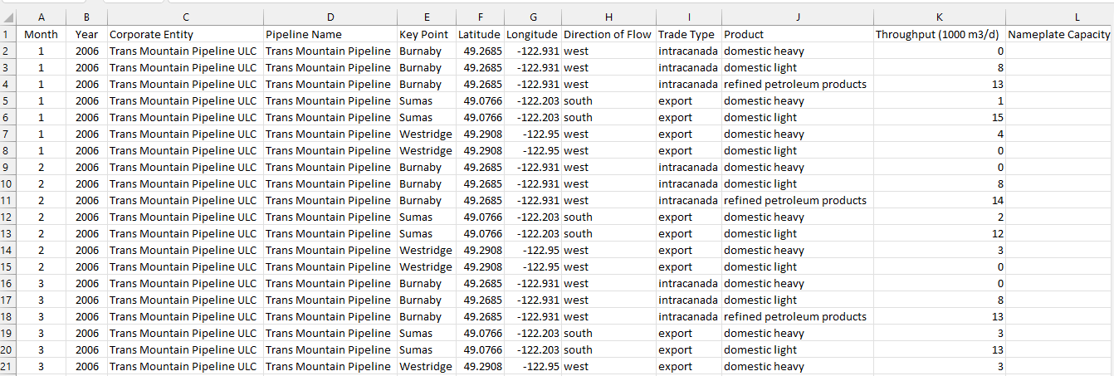
Data cleansing – Original Dataset
The dataset comprised of 14 columns and 1218 rows
Notes:
Document any data cleansing that was required, any quality issues encountered with the data.

Slide 20
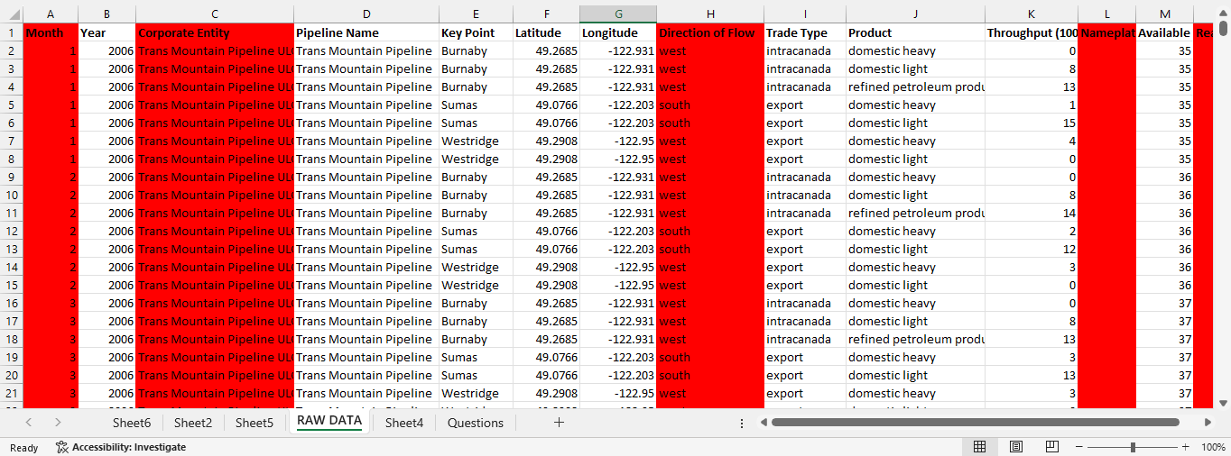
Data cleansing – Refined Dataset for further analysis
The refined dataset now comprised of 9 columns and 1218 rows.
Tool used for refinement – Microsoft Excel
Columns after cleansing
Year
Pipeline Name
Key Point
Latitude
Longitude
Trade Type
Product
Throughput (1000 m3/d)
Available Capacity (1000 m3/d)
The columns with red background are deleted. So, the refined data now constitutes 9 columns.
Notes:
Document any data cleansing that was required, any quality issues encountered with the data.

Slide 21
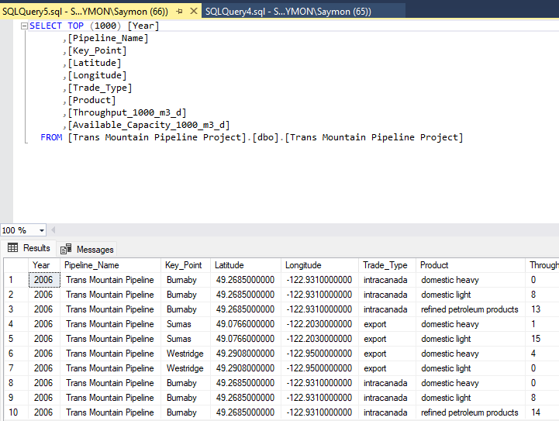
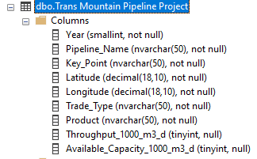
Data Preparation – Importing Excel data in SSMS
The data is saved as Trans Mountain Pipeline Project OLTP in the SSMS. The data is OLTP data (Transactional data and less refined)
Notes:
Use the SQL Server Management Studio (SSMS) tool to produce the SQL Query.
In this slide provide the SQL Query in text format, not screen shot format.

Slide 22
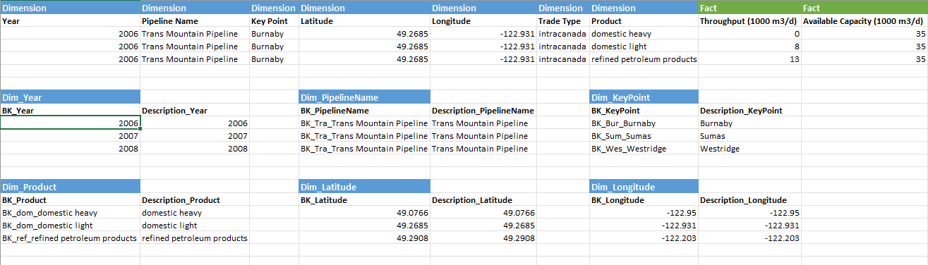
Data Preparation – Derivation of Dimensions and Facts
This step involves identification of Dimensions and Facts:
Dimensions (Year, Pipeline Name, Key Point, Latitude, Longitude, Trade Type and Product). These dimensions would be base components of Data Warehouse (DW). This is OLAP data which is more useful from the analytical perspective
Facts (Throughput and Available Capacity)
*BK represents Business Key
Notes:
Use the SQL Server Management Studio (SSMS) tool to return the results of the SQL Query.
In this slide have a screen shot of the results.

Slide 23
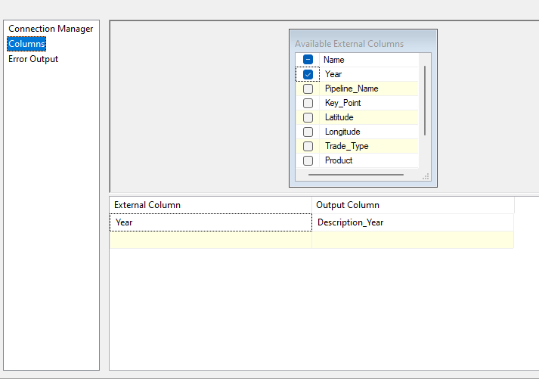
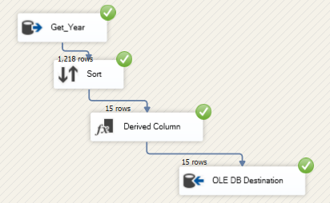
Data Preparation – Creation of Dimensions in SSIS (1 / 3)
1 step - Get_Year
Notes:
Use the SQL Server Management Studio (SSMS) tool to produce the SQL Query.
In this slide provide the SQL Query in text format, not screen shot format.

Slide 24
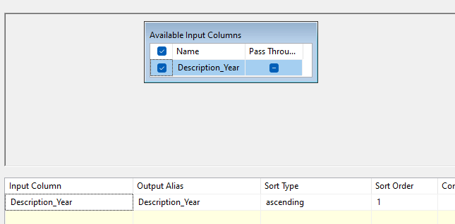
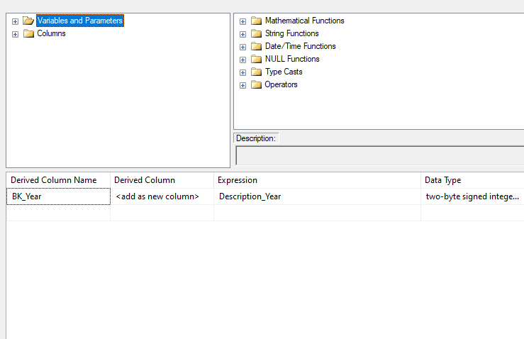
Data Preparation – Creation of Dimensions in SSIS (2/3)
2nd Step - Sort
3rd Step - Derived Column
Notes:
Use the SQL Server Management Studio (SSMS) tool to return the results of the SQL Query.
In this slide have a screen shot of the results.

Slide 25
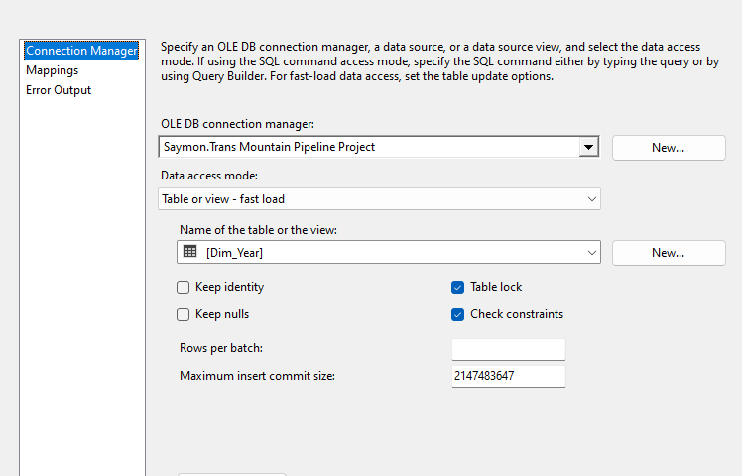
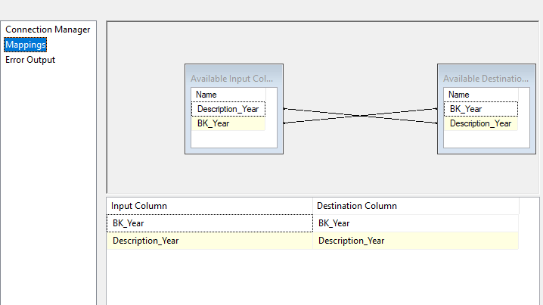
Data Preparation – Creation of Dimensions in SSIS (3 /3)
4th Step - Dim_Year
Notes:
Use the SQL Server Management Studio (SSMS) tool to return the results of the SQL Query.
In this slide have a screen shot of the results.

Slide 26
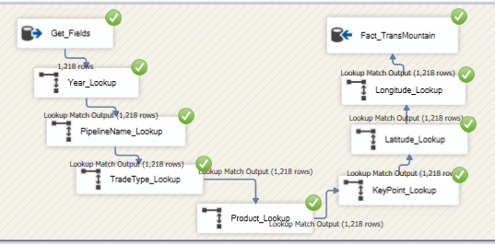
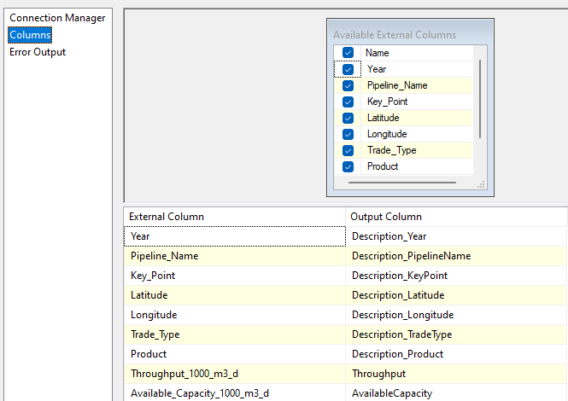
Data Preparation – Creation of Facts in SSIS
Step1 - Get_Fields
Notes:
Use the SQL Server Management Studio (SSMS) tool to return the results of the SQL Query.
In this slide have a screen shot of the results.

Slide 27
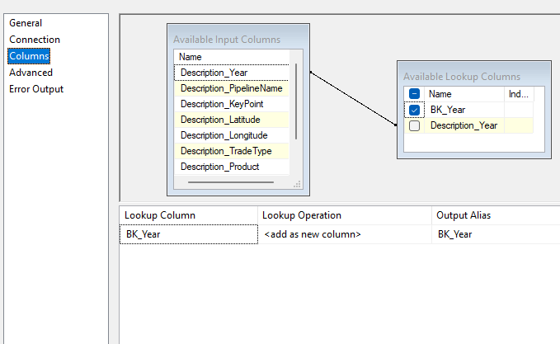
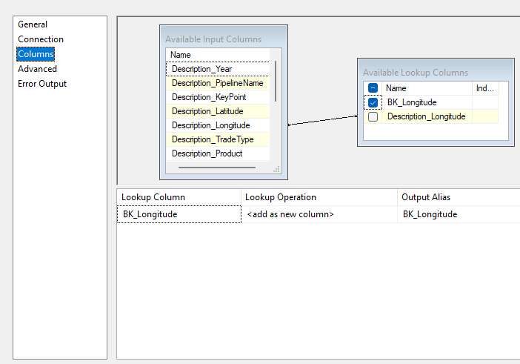
Data Preparation – Creation of Facts in SSIS
Step2 - Year Look up
Step3 - Longitude Look up
Notes:
Use the SQL Server Management Studio (SSMS) tool to return the results of the SQL Query.
In this slide have a screen shot of the results.

Slide 28
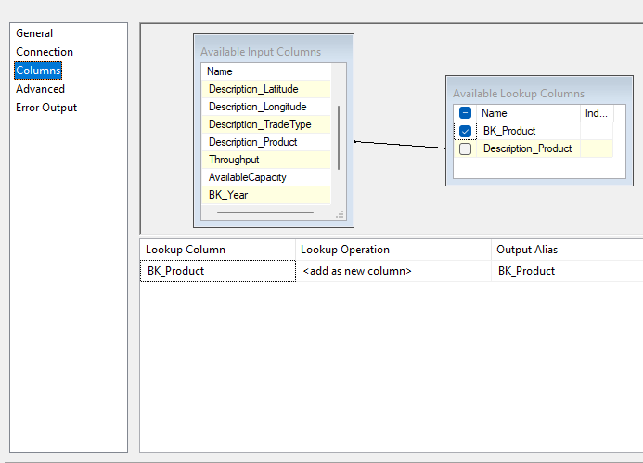
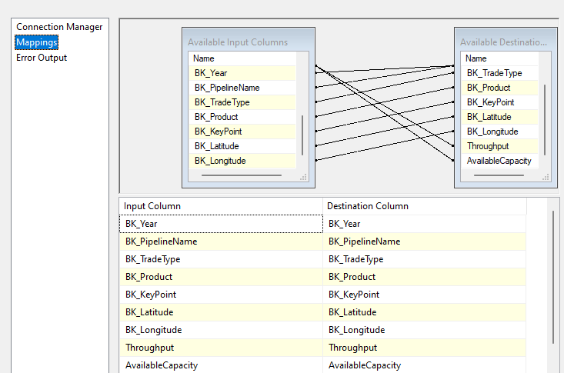
Data Preparation – Creation of Facts in SSIS
Step3 - Product Look up
Step4 - Facts_TransMountain
Notes:
Use the SQL Server Management Studio (SSMS) tool to return the results of the SQL Query.
In this slide have a screen shot of the results.

Slide 29
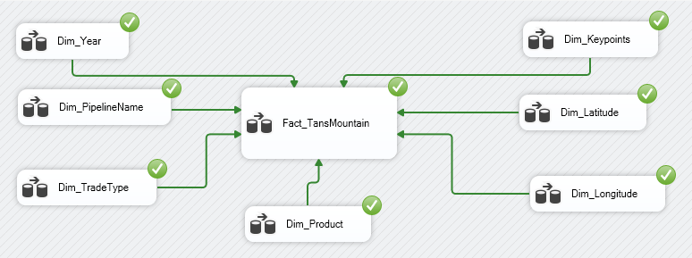
Data Preparation – Successful execution of different steps in Control Flow step of SSIS

Slide 30
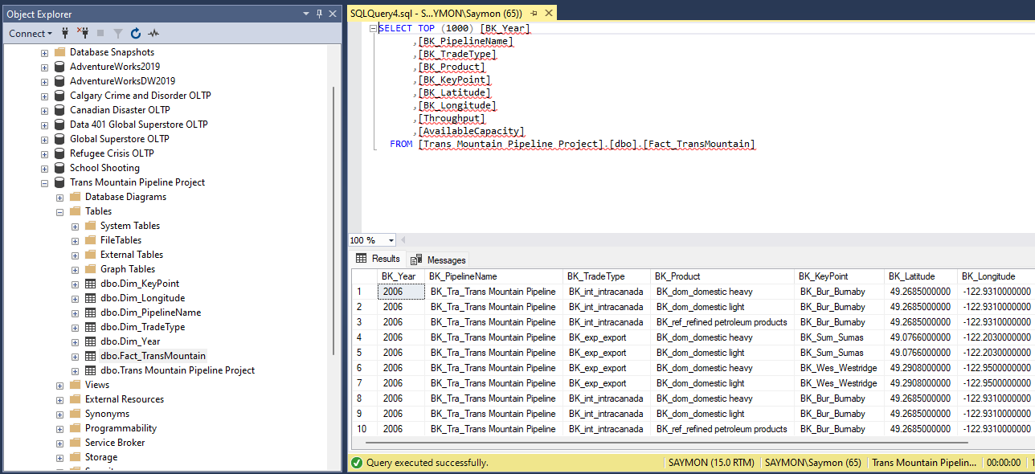
Data Preparation – Facts_TransMountain update in SSMS after successful execution of Control Task in SSIS

Slide 31
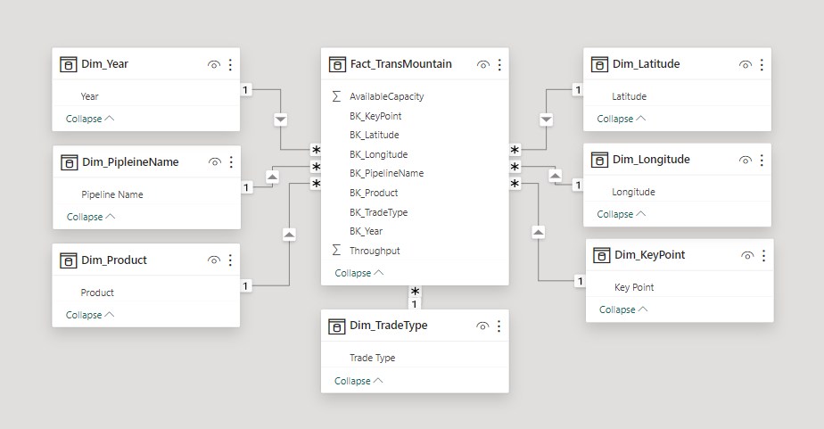
Database Diagram – Relationship between Dimensions and Facts

Slide 32
4 – Modeling

Slide 33
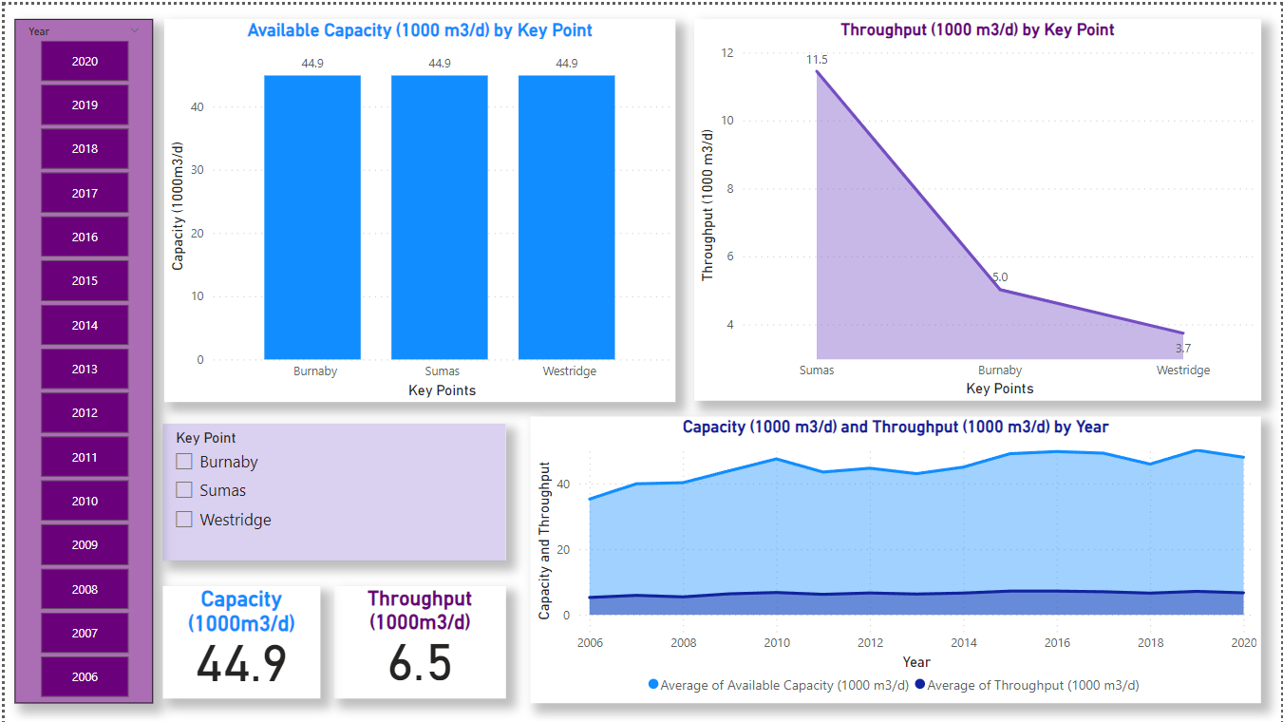

Slide 34
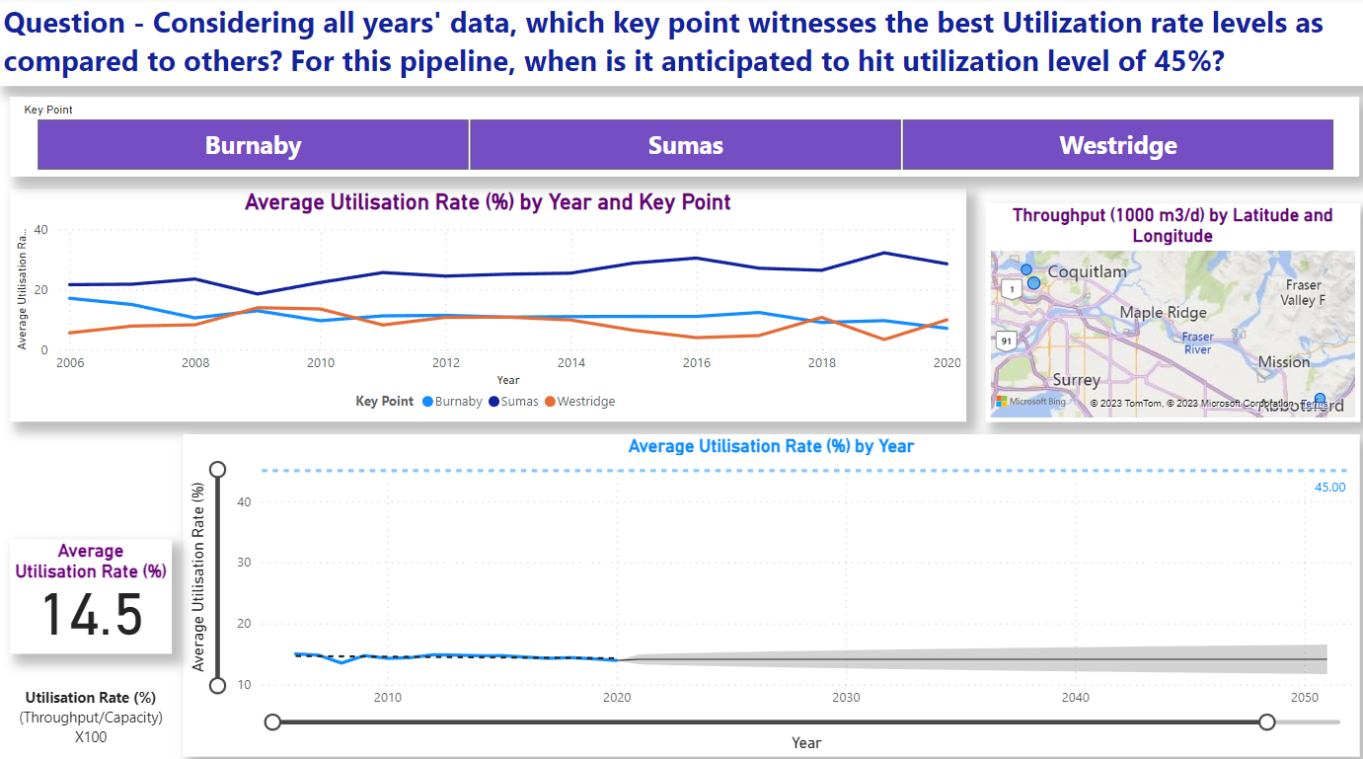

Slide 35
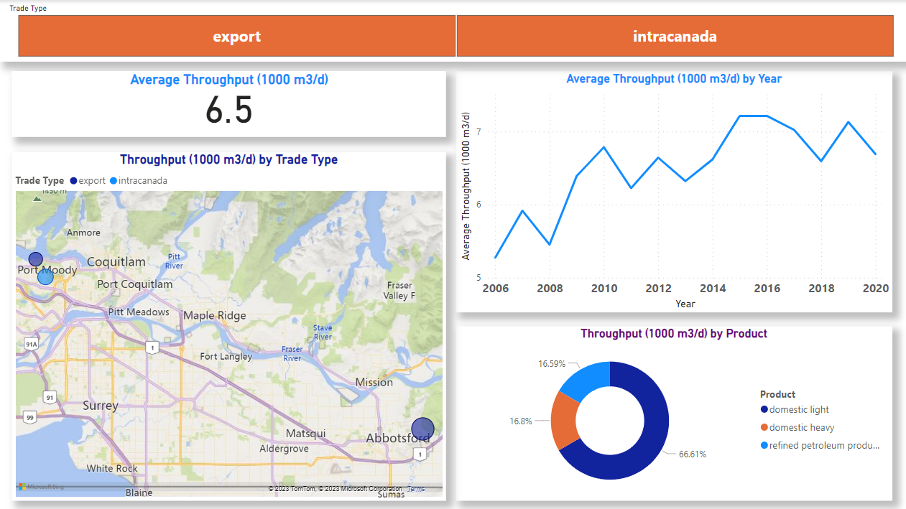

Slide 36
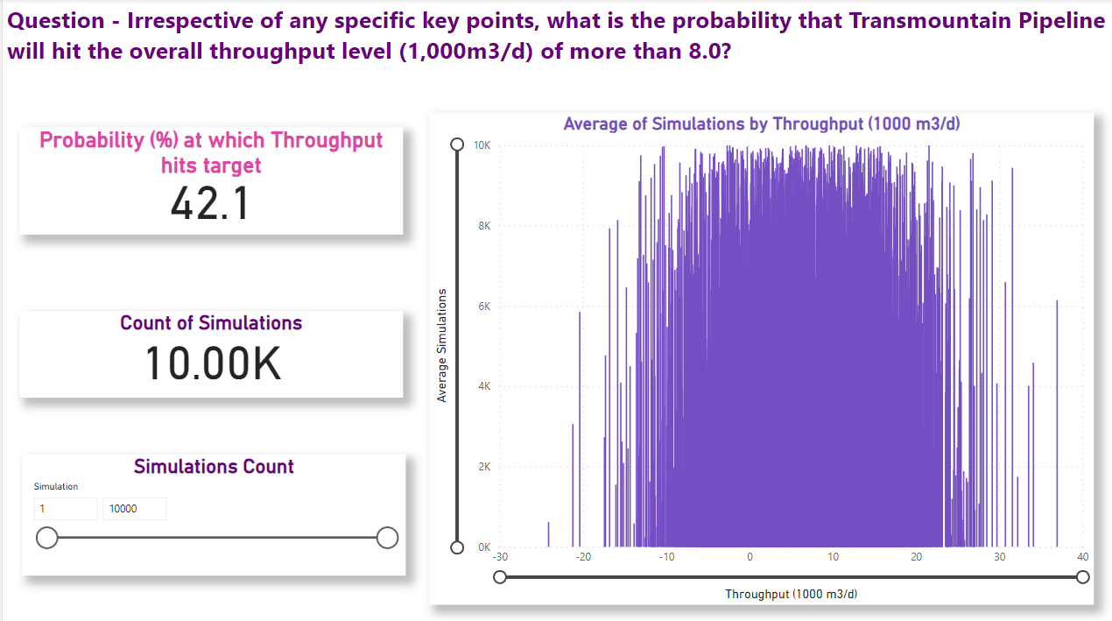

Slide 37
5 – Evaluation

Slide 38
Conclusion – Answer to Question
Question - Considering all years' data, which key point witnesses the best Utilization rate levels as compared to others? For this pipeline, when is it anticipated to hit utilization level of 45%?
Answer – Based on our analysis, Sumas key point exhibits the best utilisation rate (25.3%) vis-a-vis other two key points. Adding further analysis, it seems this key point is likely to hit target of 45% in 2043. However, there are chances to hit target before in 2035 as upper bound range of prediction is hitting target with confidence level of 95%. So, the company may monitor and evaluate this crucial indicator as well for determining the forecasted year
Question - Irrespective of any specific key points, what is the probability that Transmountain Pipeline will hit the overall throughput level (1,000m3/d) of more than 8.0?
Answer – Using the Monte Carlo Simulation, our analysis indicates that there is decent probability (~42%) of pipeline capacity hitting the throughput level of 8,000m3/d. So, decision makers may evaluate next course of action accordingly

Slide 39



